Slide 1
Python
RELEASED IN 1991

Slide 2
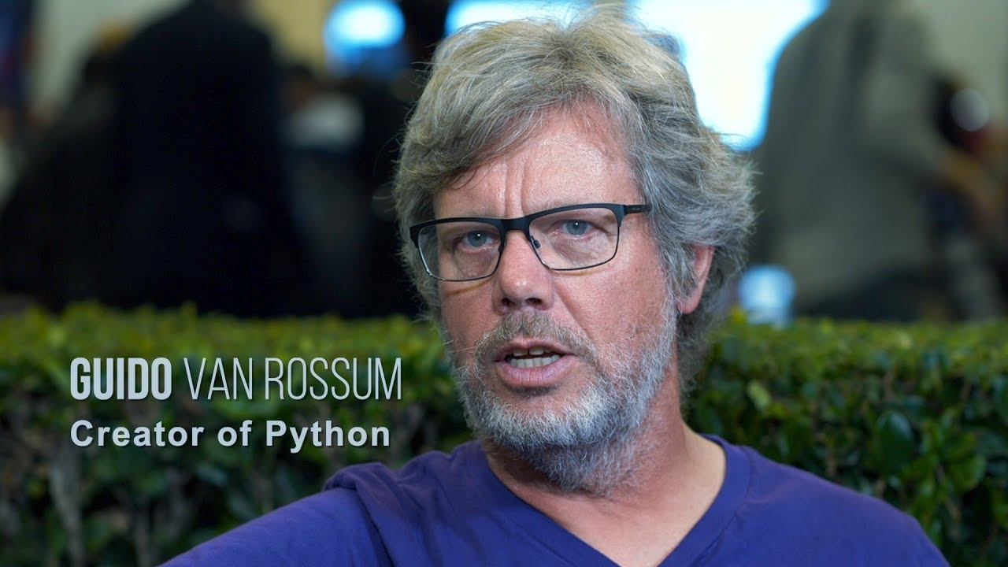
Author of python
Guido van Rossum ( 31/1/1956 - …)
Was born in Netherland
He is currently a member of the Python Steering Council.

Slide 3
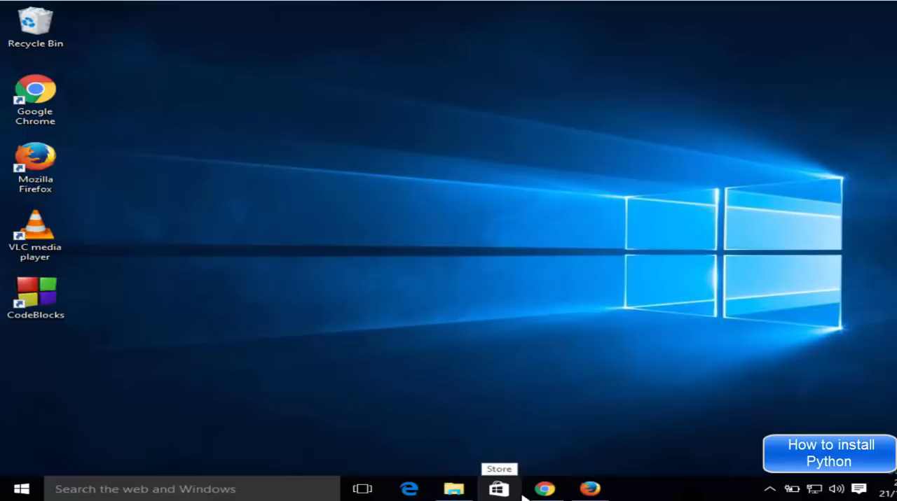
SET UP

Slide 4
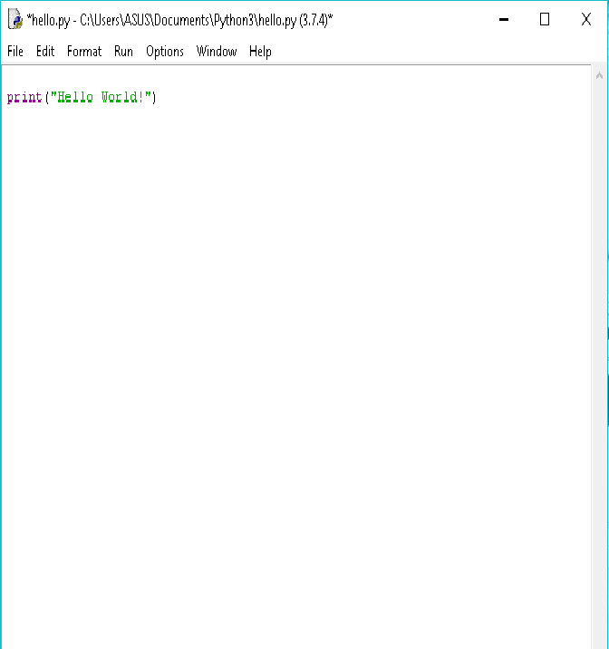

Slide 5
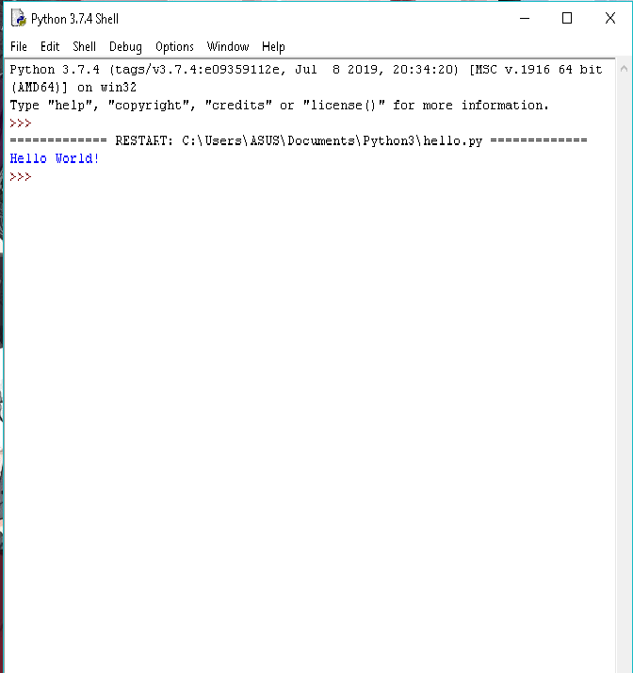

Slide 6
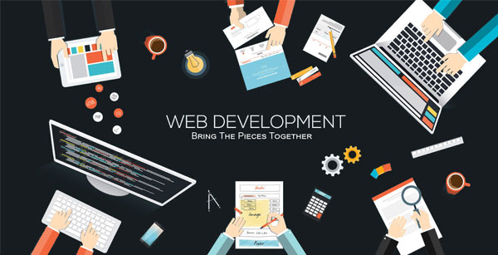
Applications of python
WEB & INTERNET DEVELOPMENT

Slide 7

Scientific & numberic

Slide 8

education

Slide 9
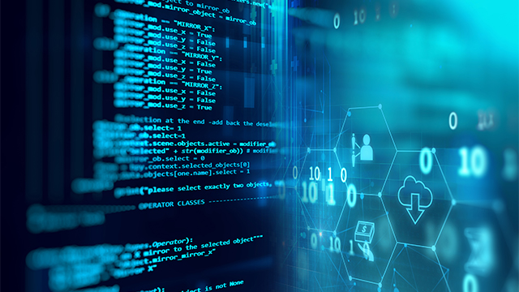
Software development

Slide 10
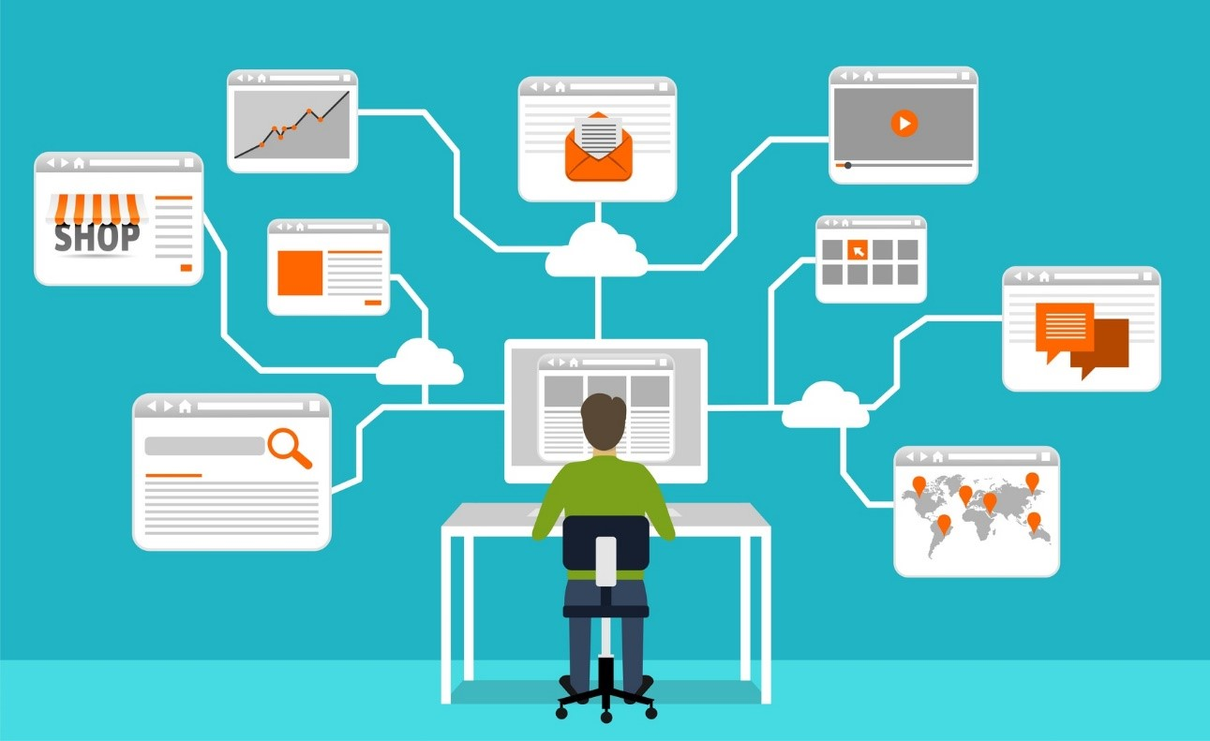
BUSINESS APPLICATION

Slide 11


Applications of python

Slide 12


Applications of python

Slide 13


Applications of python

Slide 14
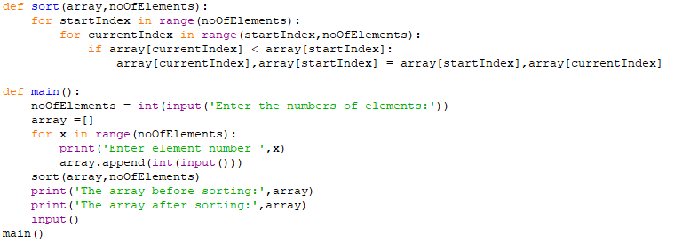
Sorting

Slide 15
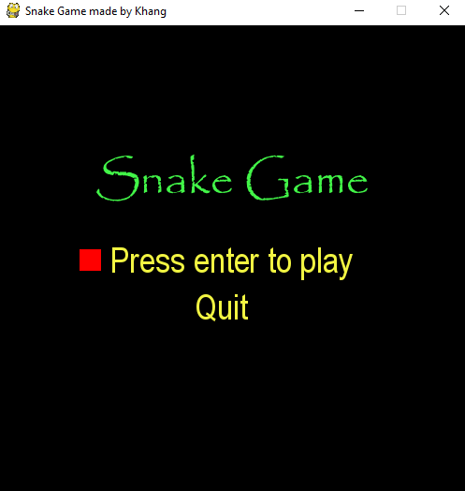
Snake game

Slide 16
advantages
Extensive Libraries:
It downloads with an extensive library, So we don’t have to write the complete code for that manually.

Slide 17
improved Productivity
The language’s simplicity and extensive libraries render programmers more productive than languages like Java and C++ do.

Slide 18
Simple and Easy
The main Python language advantages are that it is easy to read and easy to learn. It is easier to write a program in Python than in C or C++.
Which reduces the cost for maintenance of the program and seen as one of Python programming advantages.

Slide 19
disadvantages
Speed Limitations:
As an interpreted language, Python has a slow speed of execution. It is slower than C and C++ because it works with an interpreter, not the compiler.

Slide 20
Weak in Mobile Computing and Browsers
Python has high memory consumption and is not used in web browsers because it is not secure.

Slide 21
Simple
Developers like Python for its simplicity in learning and coding, so much that it might be difficult for some of them to learn and use other languages.

Slide 22
Conclusion
While being a slow language, python is relatively simple and easy to learn.
In the hands of a skilled developer, Python is one of the best programming languages.

Slide 23


